Slide 1

Final Project: ECG Signals
Ece Sarioglu, Angela Liang, Alana Young, Ankitha Nath, Siri Yarrapatni, Vivian Lam

Slide 2
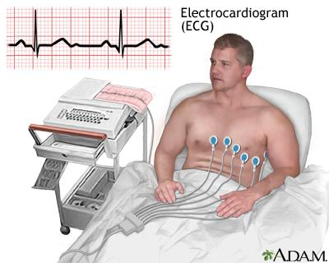
Project Overview
Using machine learning on ECG data is beneficial for early detection and treatment, so automating this process will help support those in the medical field.
ECG signals have noise that makes reading this data difficult, so denoising and streamlining this process will bridge the gap in a large biomedical problem.
Notes:
Alana

Slide 3
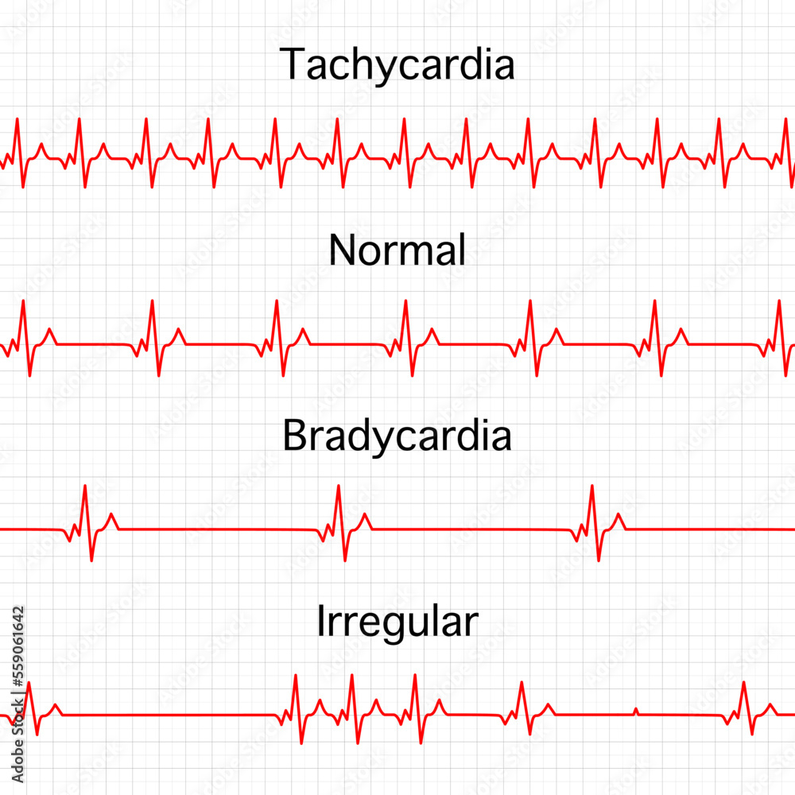
Problem
Cardiac arrhythmias are irregular heart beats which can lead to severe health issues if not detected early.
Electrocardiograms (ECG) signals are a tool for identifying cardiovascular diseases.
ECG signals contain noise and variability which can lead to complications in detection. They require accurate analysis.
Notes:
Ankitha:
Examples of arrhythmias : Atrial Rhythms like AFib, Atrial Bigeminy, AFlutter; Ventricular rhythms like ventricular bigeminy

Slide 4
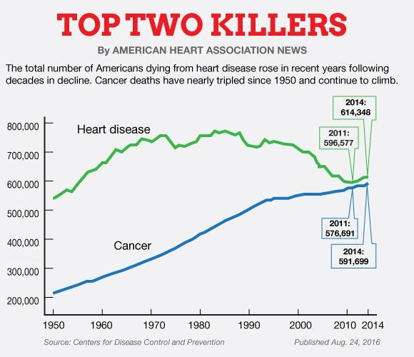
Significance
300 million ECGs performed globally each year
100 million ECGs performed in US alone
Every 33 seconds, one person dies from Cardiovascular Disease
ECG manual analysis is only accurate 55% of the time
Notes:
Ece

Slide 5
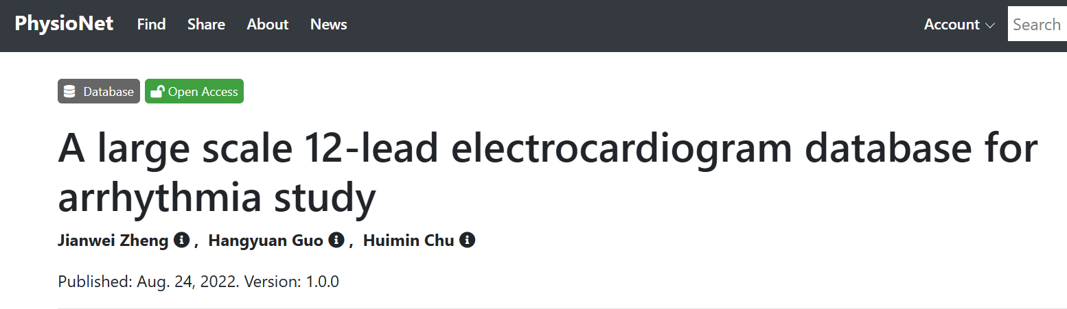
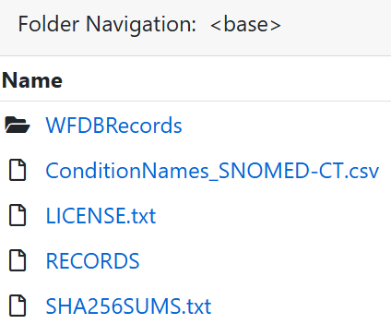
Data
The data we are using is a large scale 12-lead ECG database specific for arrhythmia study from the Chapman dataset.
Each ECG sample recording is sampled at 500Hz (high-resolution data for detailed analysis)
All signals are labels by professional experts and include a wide variety of CV conditions and common rhythms
Notes:
vivian:
used subset of the larger dataset due to computational restrictions, kernel kept crashing with larger sample number

Slide 6
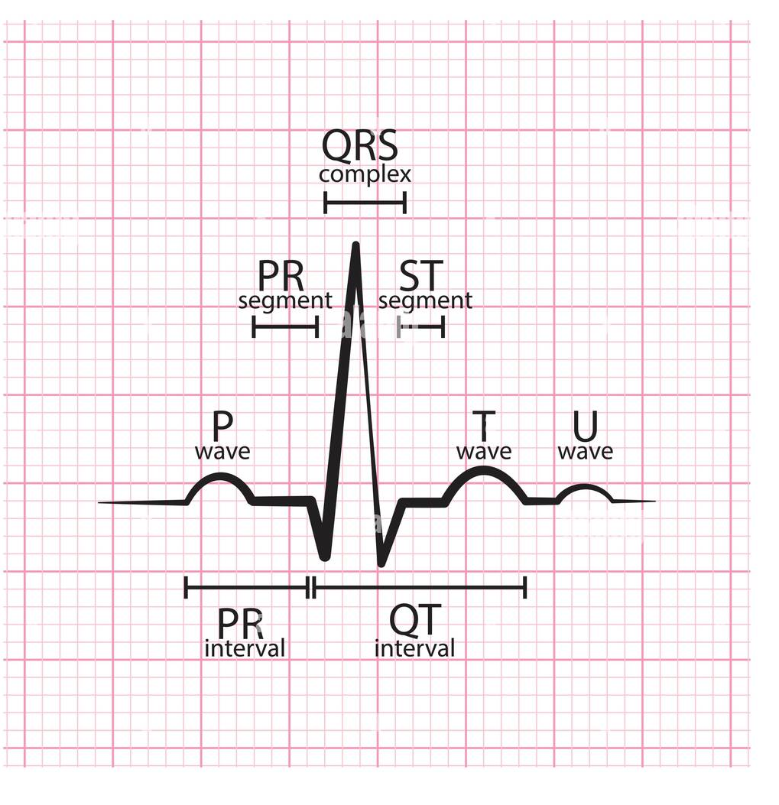
Methodology
Defined problem statement
Conducted a comprehensive literature review of ten papers pertaining to ECG signals and aspects of model learning
Installed Hugging Face Transformers and other necessary libraries
Preprocessed and tokenized the raw ECG signals from the data subset
Trained DistilBERT model using supervised learning method (labeled ECG signals).
Evaluated model effectiveness in distinguishing between normal and abnormal heart rhythms with metrics including accuracy, precision, recall, and F1-score.
Notes:
vivian

Slide 7
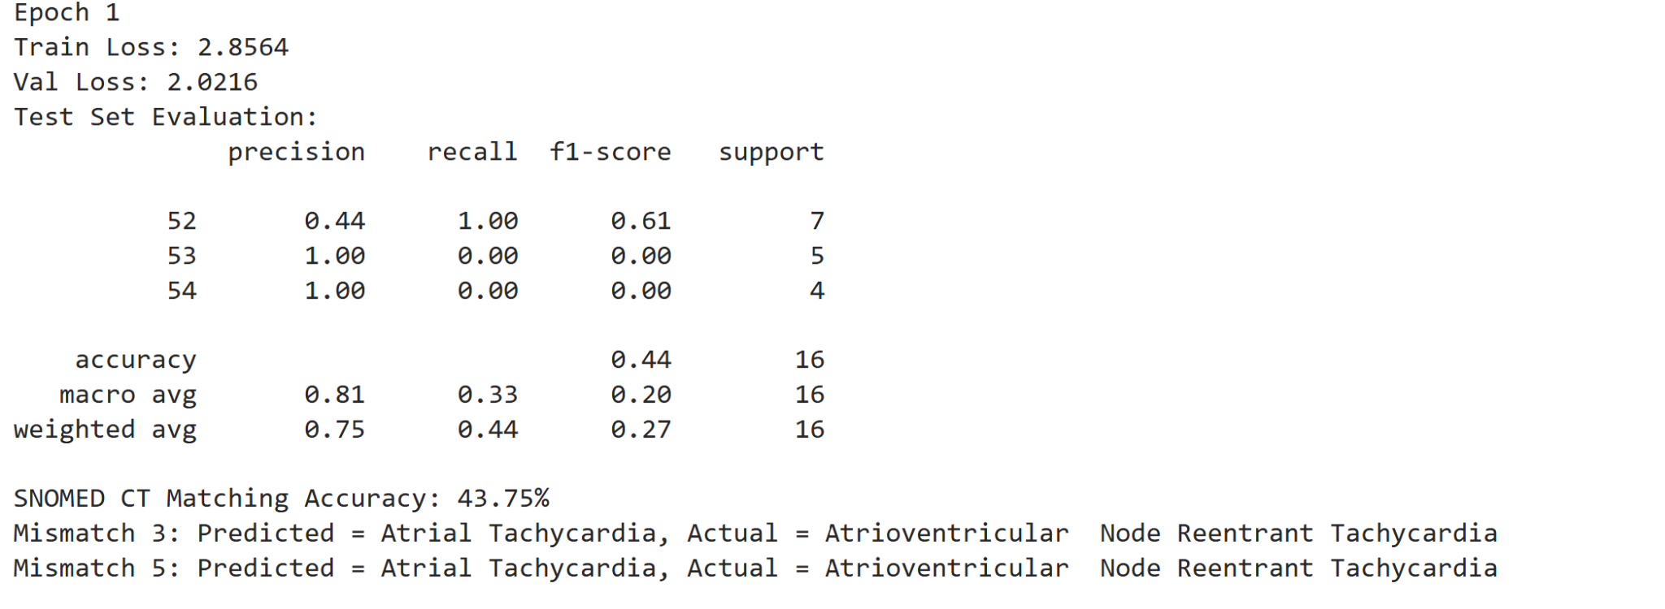
Results
Notes:
Angela Liang
*Notes: used 100 files, and only 1 epoch because kernel keeps crashing, possibly due to the large amounts of data in the dataset

